Slide 1

OopsiRoute: Optimized Route Finder
Team Members: Farheen Dhanani & Hajeera Hajeera
Course: MSCS532 Residency Project – Phase 4
Date: Oct 26th 2025

Slide 2
Agenda
• Introduction & Motivation
• Literature Review
• System Architecture
• Algorithm Design
• Performance Results
• Challenges
• Future Work
• Conclusion

Slide 3
Introduction & Motivation
• Real-world problem: Inefficient route planning increases time and energy usage.
• Objective: Develop an optimized route-finding system.
• Approach: Combine graph algorithms and performance optimization.

Slide 4
Literature Review
• Previous research focused on Dijkstra and A* algorithms.
• HPC studies show benefits of data-level and thread-level parallelism.
• Our system adapts these ideas for efficient local routing.

Slide 5
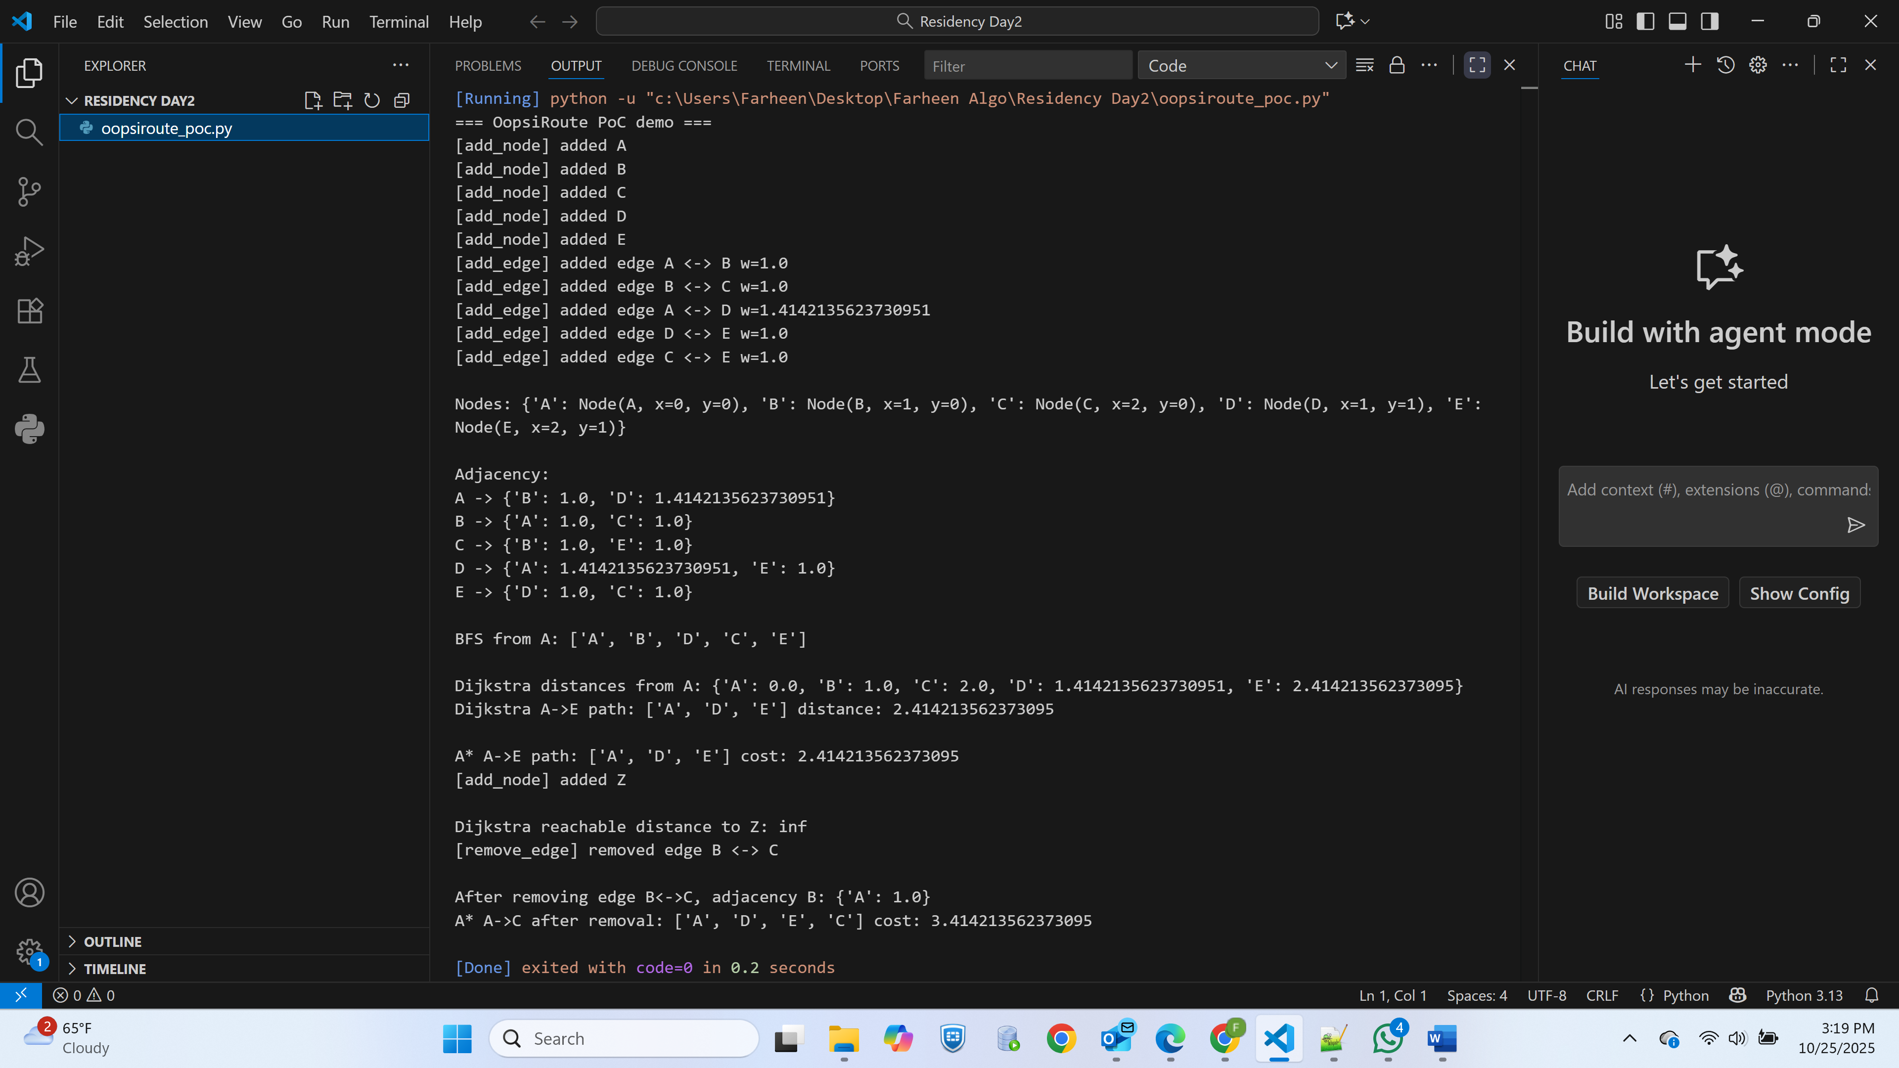
System Architecture
• Python backend for computation
• Flask API for communication
• Android frontend for user interaction

Slide 6
Algorithm Design
• Implemented Dijkstra’s Algorithm.
• Input: Graph nodes and edges.
• Output: Shortest path between source and destination.
• Optimized using numpy and memory profiling.

Slide 7
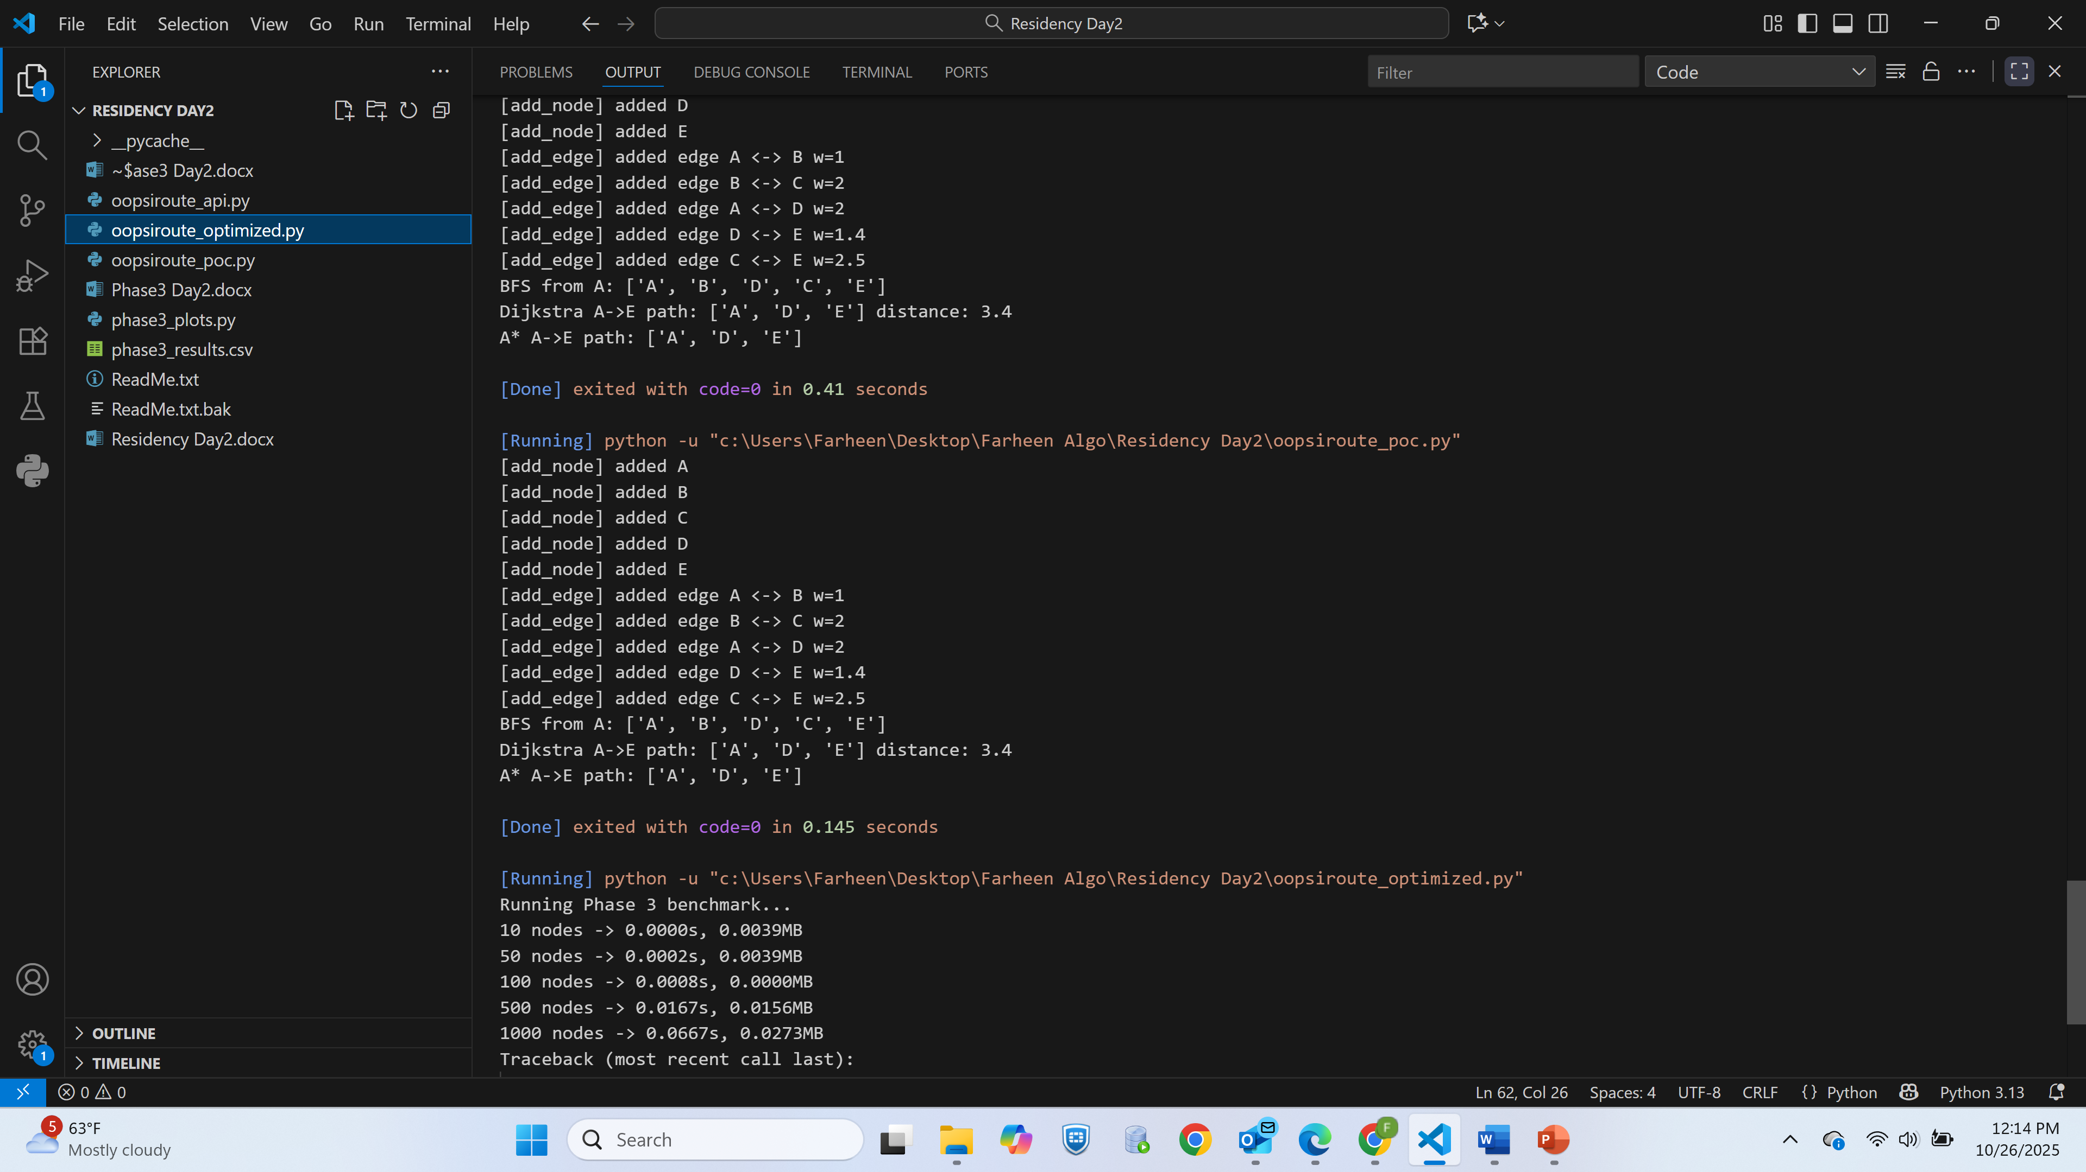
Phase 3 Optimization Results
• CSV logs collected for each experiment.
• Metrics: Execution time and memory usage.
• Sample Output: phase3_results.csv

Slide 8
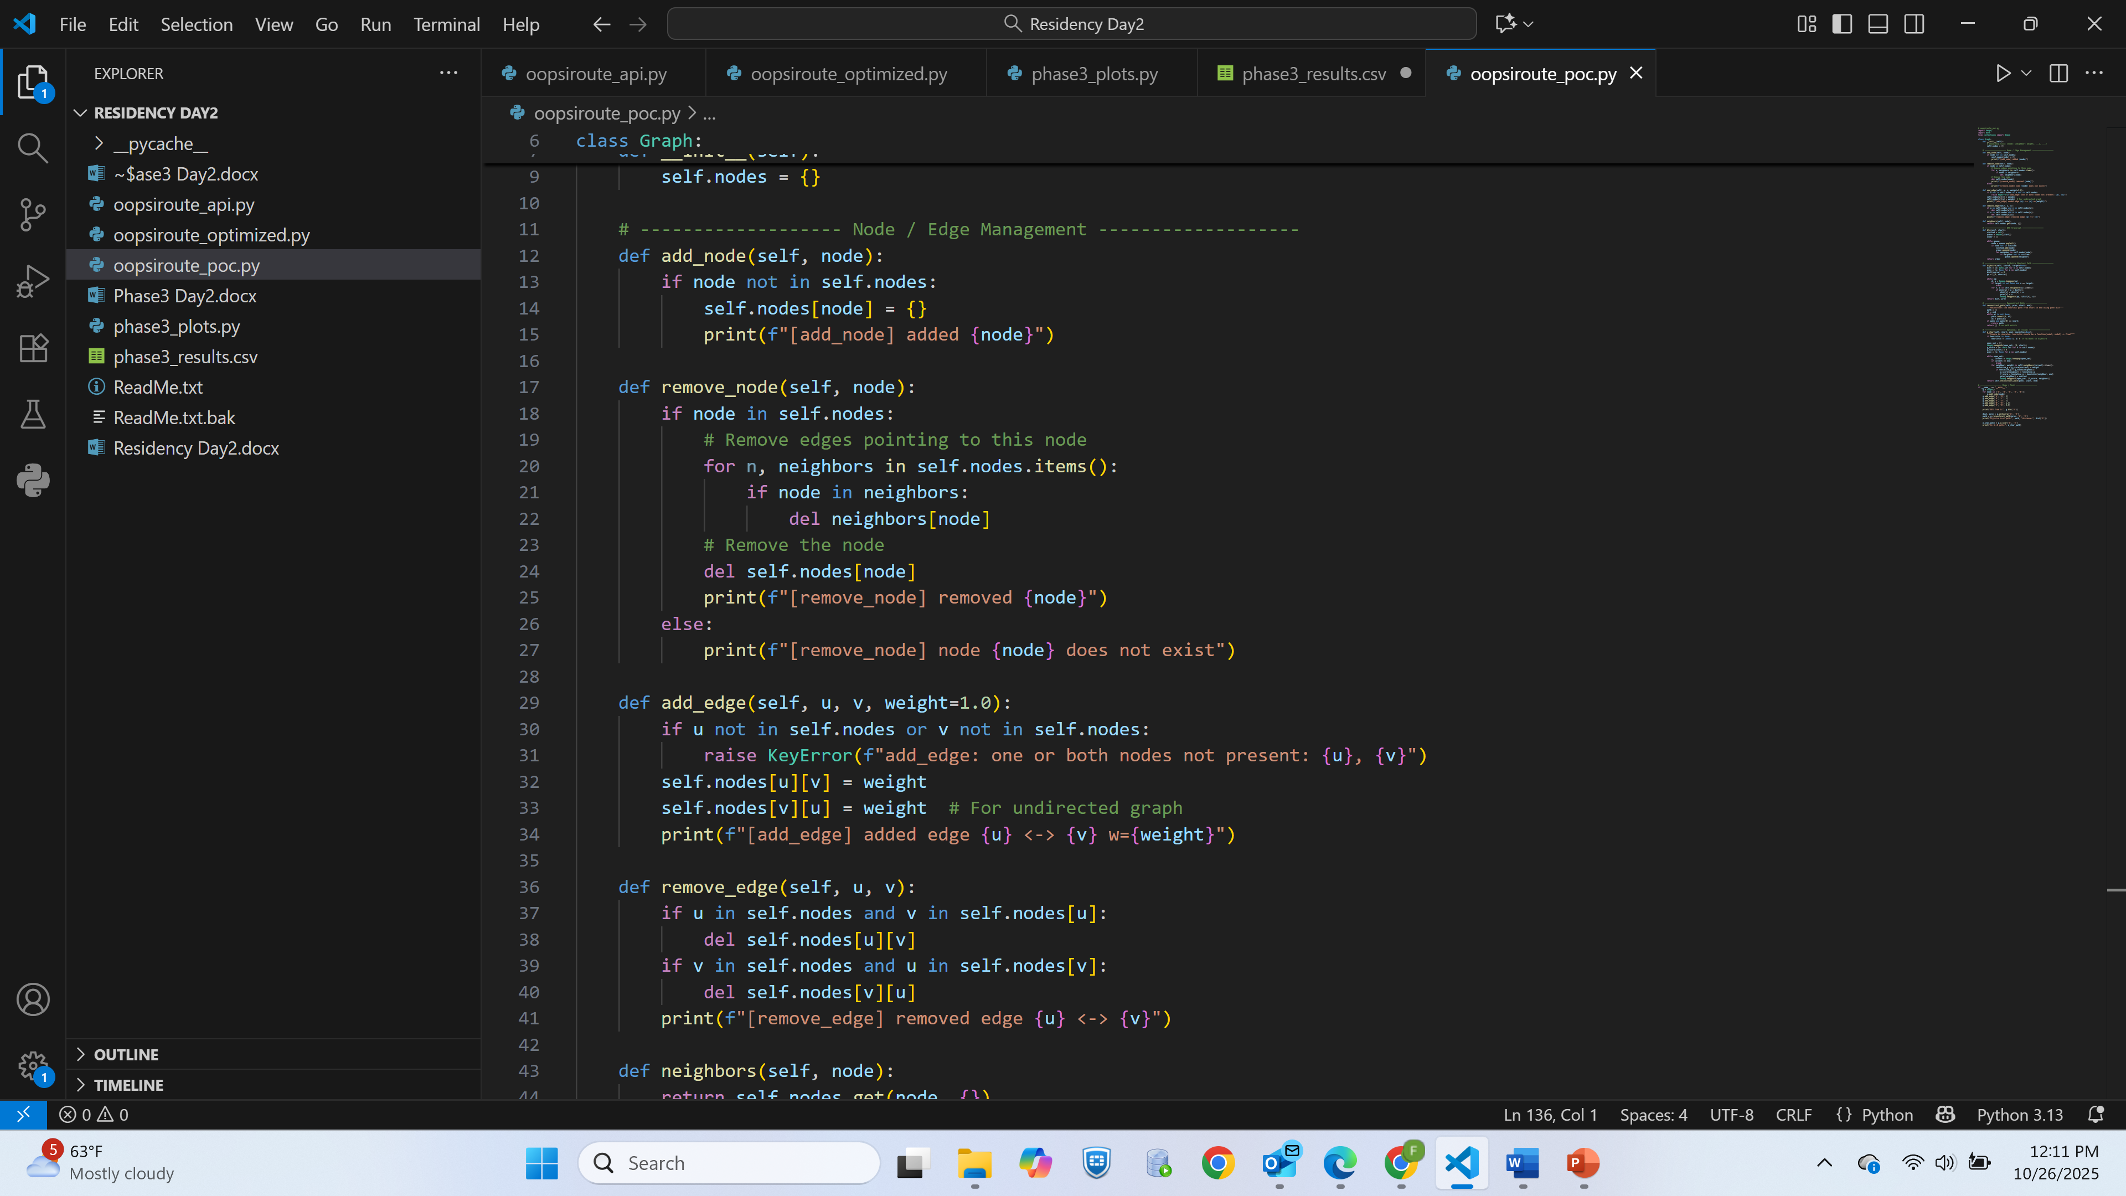
Performance Analysis
• Graphs Generated:
- time_vs_nodes.png
- memory_vs_nodes.png
- speedup_ratio.png

Slide 9
Challenges Faced
• Manifest merger errors in Android Studio.
• Missing libraries (psutil, matplotlib).
• Encoding issues with Unicode symbols.
• Coordination between Flask API and emulator.

Slide 10
Future Work
• Implement real-world map data (OpenStreetMap).
• Add multi-route comparison.
• Improve visualization in the Android app.
• Deploy backend to the cloud for scalability.

Slide 11
Conclusion & Key Learnings
• Developed an integrated route optimization system.
• Applied DLP and TLP concepts effectively.
• Improved understanding of performance profiling and HPC techniques.

Slide 12
References
Dijkstra, E. W. (1959). A note on two problems in connexion with graphs. Numerische Mathematik, 1, 269–271. https://doi.org/10.1007/BF01386390
Hart, P. E., Nilsson, N. J., & Raphael, B. (1968). A formal basis for the heuristic determination of minimum cost paths. IEEE Transactions on Systems Science and Cybernetics, 4(2), 100–107. https://doi.org/10.1109/TSSC.1968.300136
Geisberger, R., Sanders, P., Schultes, D., & Delling, D. (2008). Contraction hierarchies: Faster and simpler hierarchical routing in road networks. Experimental Algorithms, 5038, 319–333. Springer. https://doi.org/10.1007/978-3-540-68552-4_24
Goldberg, A. V., & Harrelson, C. (2005). Computing the shortest path: A* search meets graph theory. SIAM Journal on Discrete Mathematics, 18(2), 129–142.
Hagberg, A. A., Schult, D. A., & Swart, P. J. (2008). Exploring network structure, dynamics, and function using NetworkX. Proceedings of the 7th Python in Science Conference (SciPy2008), 11–15.
Zhang, Y., Chen, J., & Wang, X. (2019). Optimizing Dijkstra’s algorithm for large-scale road networks. Journal of Big Data, 6(1), 48.

